Slide 1
Identifying Covid-19 patients from Chest X-Rays
Kester chia

Slide 2
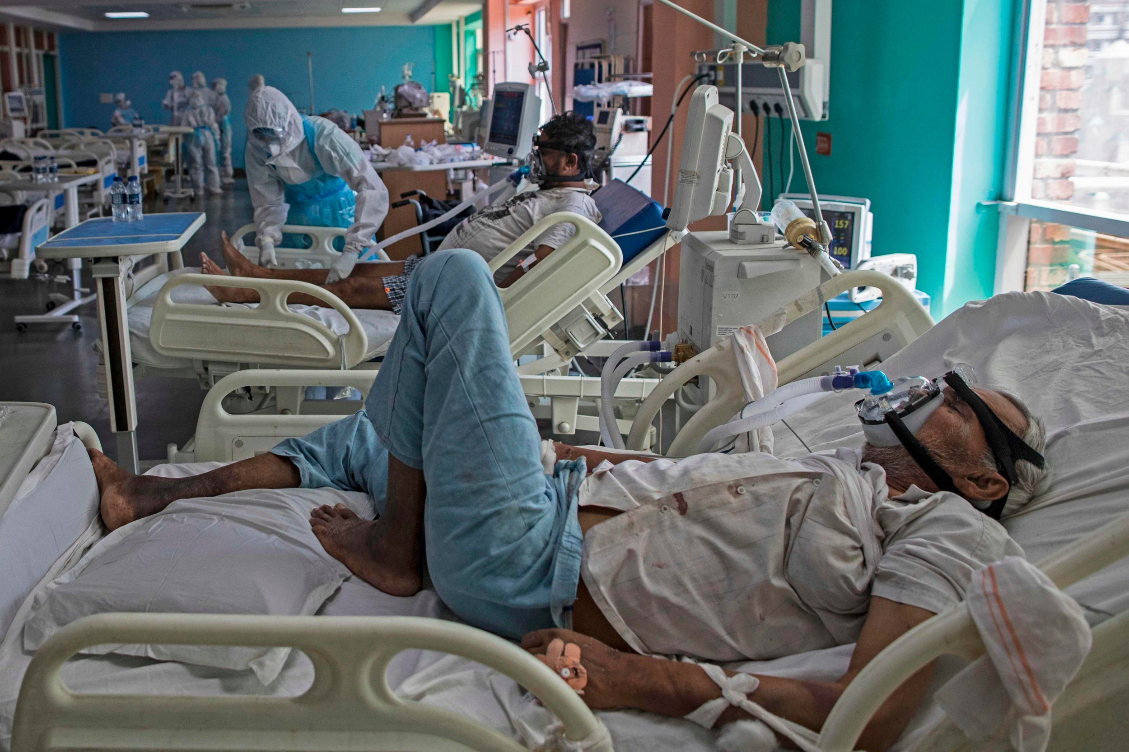
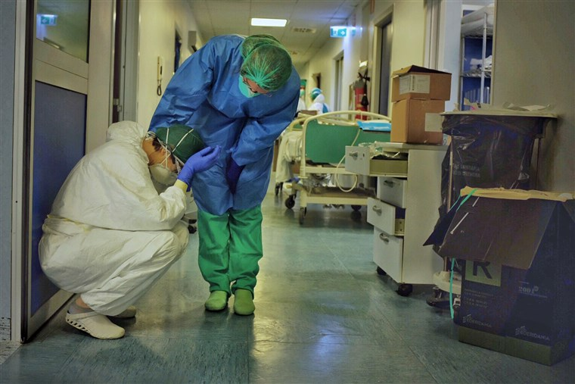
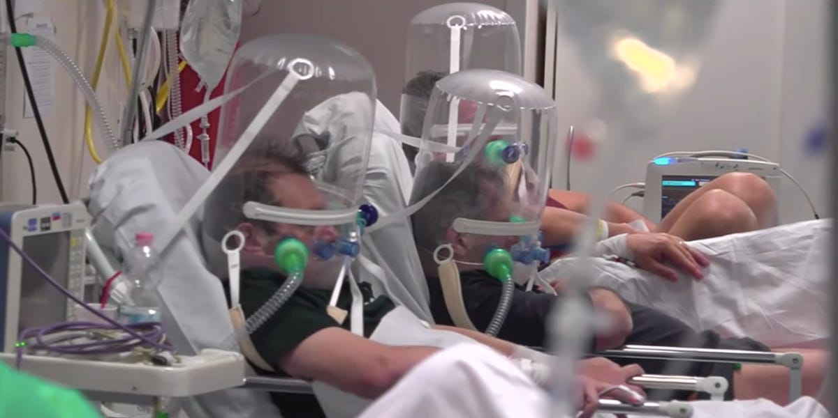
Overwhelmed Hospitals
Notes:
Sources:
https://www.nbcnews.com/health/health-news/italy-has-world-class-health-system-coronavirus-has-pushed-it-n1162786
https://www.independent.co.uk/news/world/asia/india-coronavirus-cases-deaths-million-covid-latest-a9623821.html

Slide 3
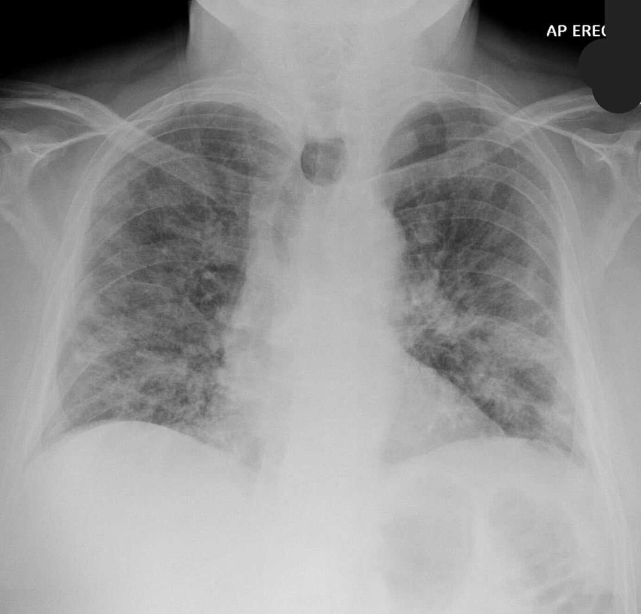
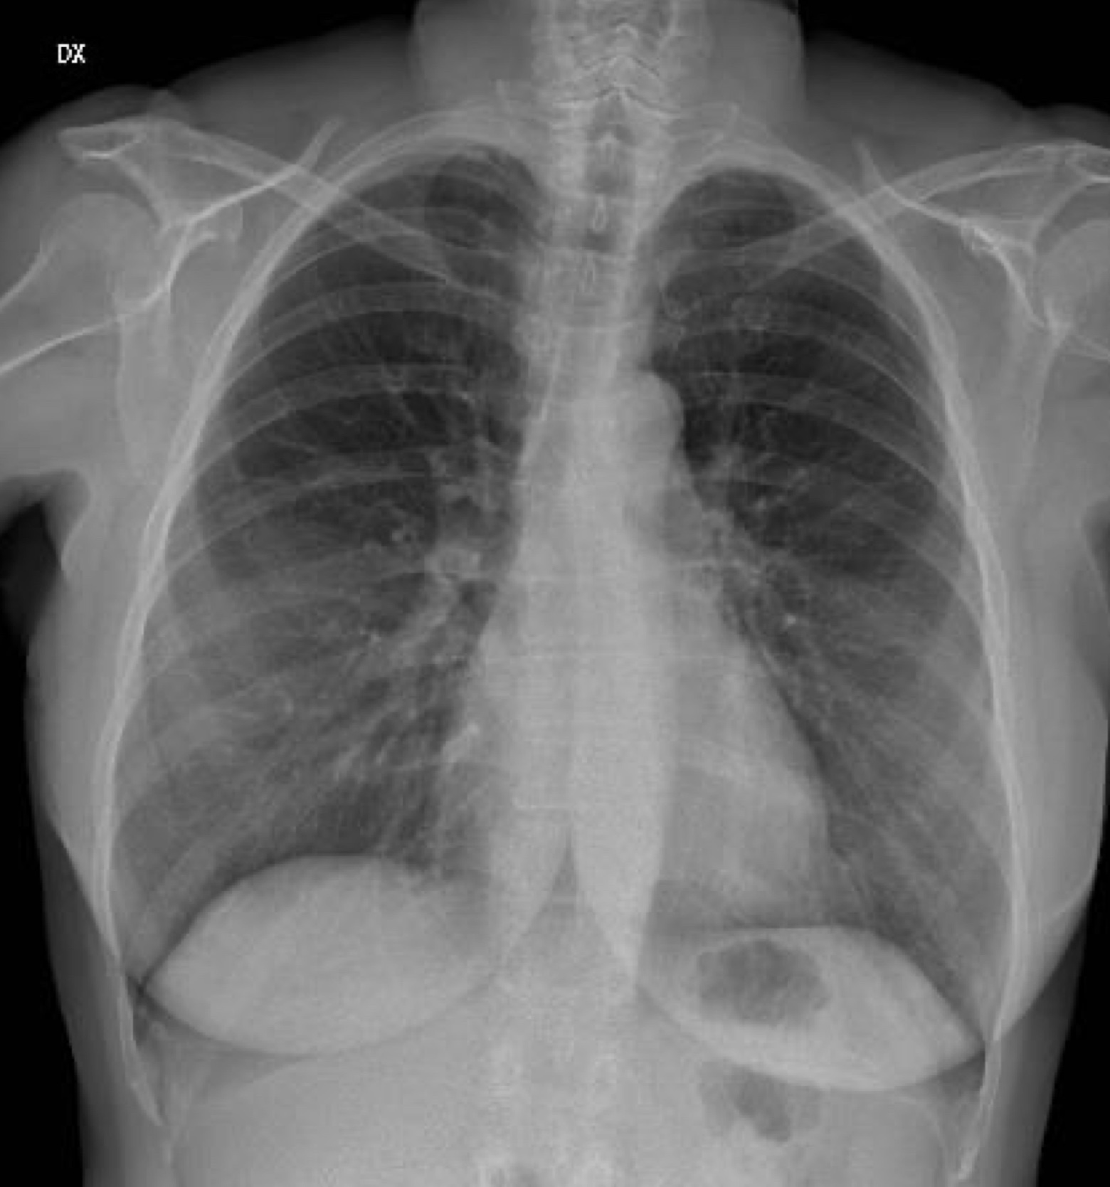
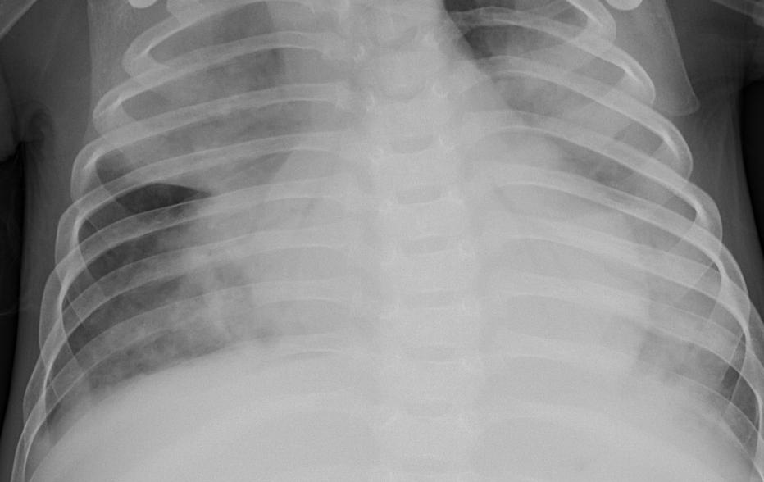
Chest X-Rays
Covid-19
Bacterial
Healthy
Notes:
Sources:
https://www.latimes.com/world-nation/story/2020-05-13/in-wuhan-new-coronavirus-infections-spark-mass-testing-renewed-restrictions-and-residents-worries

Slide 4
Building a model to detect infections
Detect
Detect presence of infection, as well as type (Viral/Bacterial)
Streamline
Streamline case detection and save hospital resources
Relieve
Relieve burden on healthcare systems

Slide 5
Model choice: Convolutional neural network
Commonly used for image classification problems
Well established CNN architectures available to use as a starting point, instead of starting from scratch (LeNet-5, AlexNet, VGG etc.)
Images are not sequential, therefore Recurrent Neural Networks (RNNs) are not relevant

Slide 6
Dataset

